Slide 1

CARC103 – Computer Architecture
Kent Institute Australia Pty. Ltd.
ABN 49 003 577 302 CRICOS Code: 00161E RTO Code: 90458 TEQSA Provider Number: PRV12051

Slide 2
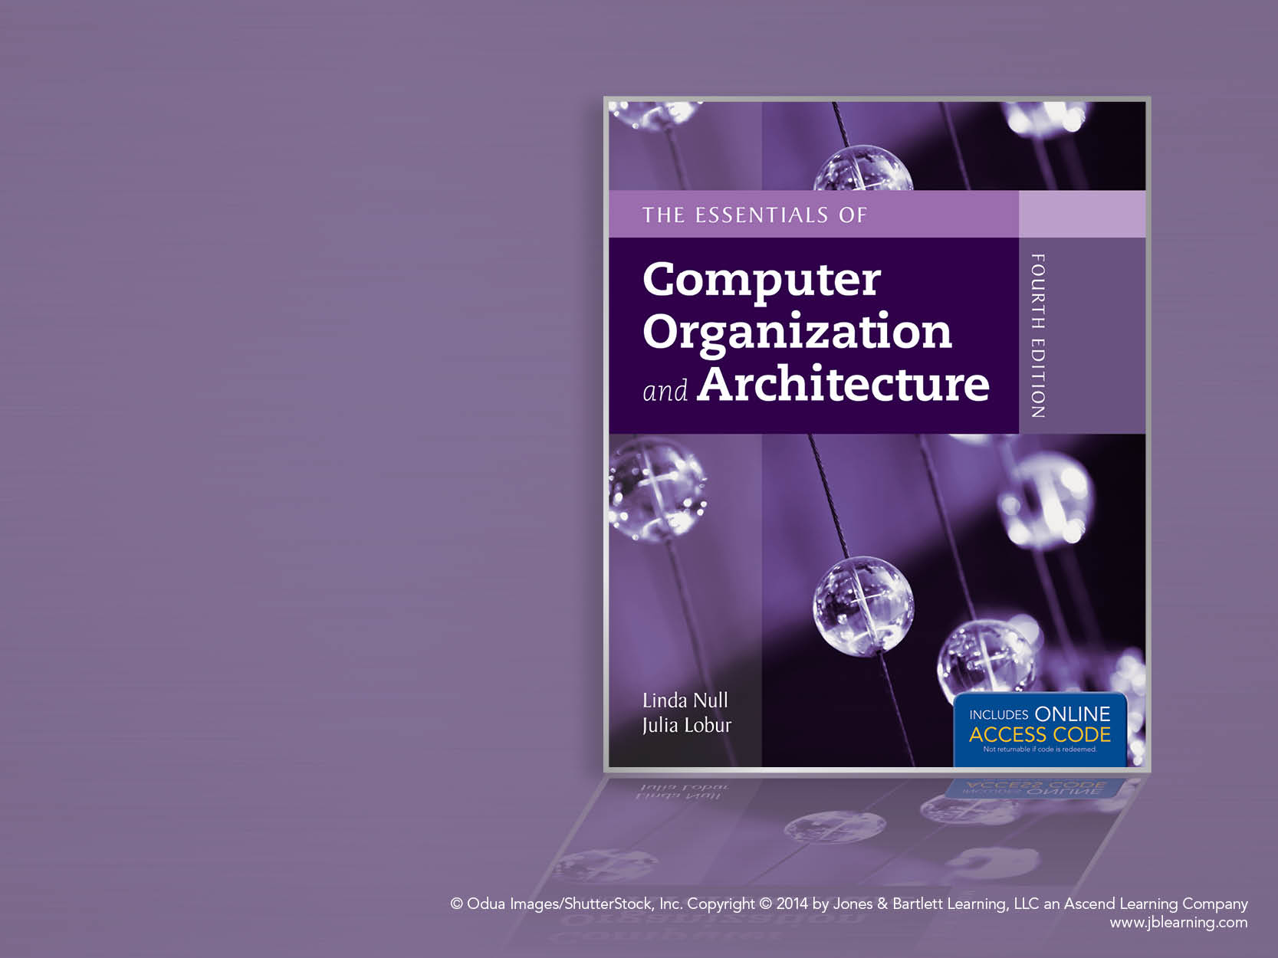
Chapter 6
Memory

Slide 3
Chapter 6 Objectives
Master the concepts of Cache memory and Virtual Memory.
Master the concepts behind memory segmentation, paging and address translation.

Slide 4
6.4 Cache Memory – Set Associative Mapped Cache
Set associative cache combines the ideas of direct mapped cache and fully associative cache.
An N-way set associative cache mapping is like direct mapped cache in that a memory reference maps to a particular location in cache.
Unlike direct mapped cache, a memory reference maps to a set of several cache blocks, similar to the way in which fully associative cache works.
Instead of mapping anywhere in the entire cache, a memory reference can map only to the subset of cache slots.

Slide 5
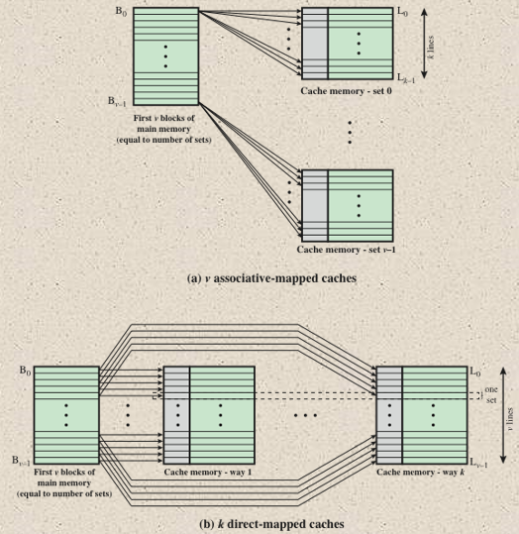
6.4 Cache Memory – Set Associative Mapped Cache
Set-associative mapping: Set-associative mapping is a compromise that exhibits the strengths of both the direct and associative approaches while reducing their disadvantages.

Slide 6
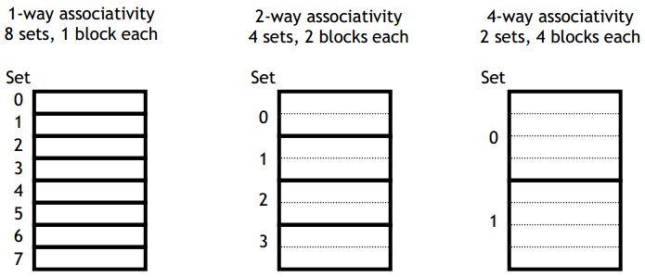
6.4 Cache Memory – Set Associative Mapped Cache
The cache is divided into groups of blocks, called sets
Each memory address maps to exactly one set in the cache, but data may be placed in any block within that set.
If each set has X blocks, the cache is an X way associative cache

Slide 7
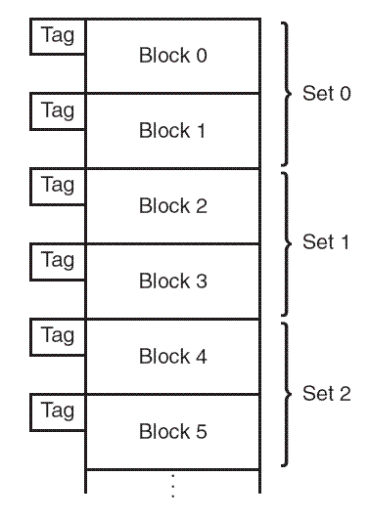
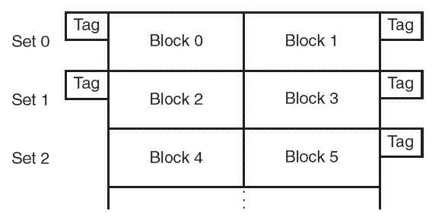
6.4 Cache Memory – Set Associative Mapped Cache
The number of cache blocks per set in set associative cache varies according to overall system design.
For example, a 2-way set associative cache can be conceptualized as shown in the schematic below.
Each set contains two different memory blocks.
Logical view
Linear view

Slide 8
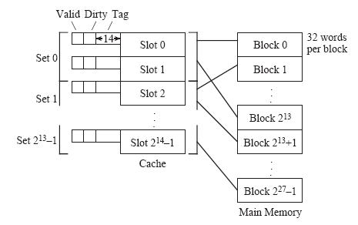
6.4 Cache Memory – Set Associative Mapped Cache
Combines the simplicity of direct mapping with the flexibility of associative mapping
Example we have 2²⁷ memory blocks and 2¹⁴ cache slots.
Two slots make up a set. Since there are 2¹⁴ slots in the cache, there are 2¹⁴/2 =2¹³ sets.

Slide 9
6.4 Cache Memory – Set Associative Mapped Cache
In set associative cache mapping, a memory reference is divided into three fields: tag, set, and offset.
As with direct-mapped cache, the offset field chooses the word (offset) within the cache block, and the tag field uniquely identifies the memory address.
The set field determines the set to which the memory block maps.
Tag | Set | Offset

Slide 10
6.4 Cache Memory – Set Associative Mapped Cache
2 blocks each (set)
Example (4): A 2-way set-associative cache consists of four sets. Main memory contains 2K blocks of eight words each, and word addressing is used. Show the main memory address format that allows us to map addresses from main memory to cache. Be sure to include the fields as well as their sizes.
MM: 2K blocks = 2 * 2¹⁰ = 2¹¹ Blocks
8 words each Block = 2³ words/Block
Cache: 4 sets of blocks (Set Field) = 2²
MM Capacity (Address Bits) = 2K blocks of 8 words per block
= 2 * 2¹⁰ * 2³ = 2¹⁴ Block * Word / Block
= 2¹⁴ Words → 14 bits address
Offset = 8 words = 2³ → 3 bits required
Set Field = 4 sets = 2² → 2 bits required
Tag = 14 – (2 + 3) = 9 bits left over
Tag | Set | Offset
9 bits | 2 bits | 3 bits
14 bits address

Slide 11
6.4 Cache Memory – Set Associative Mapped Cache
Q5: Consider a byte-addressable computer with 24-bit addresses, a cache capable of storing a total of 64K bytes of data and blocks of 32 bytes. Show the format of a 24-bit memory address for:
Direct mapped
Associative
4-way set associative
Direct mapped memory address format: Tag, Block, Offset
MM address = 24 bits = 224 bytes address
Offset = number of bytes in each block = 32 bytes = 25 → 5 bits for Offset field
No. of Cache Blocks = Totla Cache size/ Cache block size= 64K/32 byte
= 26 * 210 / 25
= 216 / 25 bytes = 211 → 11 bits for Block field
Bits left over = 24 - (5+11) = 8 bits for Tag field
Known:
- number of bits for MM address → 24 bits
- CM capacity = 64K = 26 * 210 = 216 bytes
- 1 block = 32 bytes
b. Associative memory address format: Tag, Offset
Offset = number of bytes in each block = 32 bytes
= 25 → 5 bits for Offset field
Bits left over = 24 – 5 = 19 bits for Tag field
c. 4-way set associative address format: Tag, Set, Offset
Offset = number of bytes in each block = 32 bytes = 25 → 5 bits for Offset field
4-way set associative → 4 blocks/set;
No. of sets = No. of blocks/No. of blocks per set = 211 / 4 = 211-2 = 29 → 9 bits for Set field
Bits left over = 24 – (5 + 9) = 10 bits for Tag field

Slide 12

6.4 Cache Memory – Set Associative Mapped Cache
Q6: Suppose a word-addressable computer using set associative cache has 2¹⁶ words of main memory and a cache of 32 blocks, and each cache block contains 8 words.
If this cache is 2-way set associative, what is the format of a memory address as seen by the cache, that is, what are the sizes of the tag, set, and offset fields?
If this cache is 4-way set associative, what is the format of a memory address as seen by the cache?

Slide 13
6.4 Cache Memory – Set Associative Mapped Cache
Q7: Suppose a byte-addressable computer using set associative cache has 2²¹ byes of main memory and a cache of 64 blocks, where each cache block contains 4 bytes.
If this cache is 2-way set associative, what is the format of a memory address as seen by the cache, that is, what are the sizes of the tag, set, and offset fields?
If this cache is 4-way set associative, what is the format of a memory address as seen by the cache?

Slide 14
6.4 Cache Memory - Dirty Blocks
Cache replacement policies must take into account dirty blocks, those blocks that have been updated while they were in the cache.
Dirty blocks must be written back to memory. A write policy determines how this will be done.
There are two types of write policies,
write through, and
write back.
Write through updates cache and main memory simultaneously on every write.
Write back (also called copyback) updates memory only when the block is selected for replacement.

Slide 15
6.4 Cache Memory
The disadvantage of write through is that:
memory must be updated with each cache write, which slows down the access time on updates. This slowdown is usually negligible, because the majority of accesses tend to be reads, not writes.
The advantage and disadvantage of write back is that:
memory traffic is minimized, but its disadvantage is that memory does not always agree with the value in cache, causing problems in systems with many concurrent users.

Slide 16
6.4 Cache Memory _ Cache Organization
• Location – how do you locate a block
• Placement – where is a block placed
With fully associative and set associative cache, a replacement policy is invoked when it becomes necessary to evict a block from cache.
• Re-placement – which block do you replace
– Least recently used (LRU), any block that has been unused for a longer period of time than the others is replaced.
– FIFO, the longest live block is replaced.
– Random, as the name suggests..

Slide 17
6.4 Cache Memory _ Cache Write Policy Types
The replacement policy that we choose depends upon the locality that we are trying to optimize-- usually, we are interested in temporal locality.
A least recently used (LRU) algorithm keeps track of the last time that a block was assessed and evicts the block that has been unused for the longest period of time.
The disadvantage of this approach is its complexity: LRU has to maintain an access history for each block, which ultimately slows down the cache.
First-in, first-out (FIFO) is a popular cache replacement policy. In FIFO, the block that has been in the cache the longest, regardless of when it was last used.
A random replacement policy does what its name implies: It picks a block at random and replaces it with a new block. Random replacement can certainly evict a block that will be needed often or needed soon, but it never thrashes.

Slide 18
6.5 Virtual Memory
Cache memory enhances performance by providing faster memory access speed.
Virtual memory enhances performance by providing greater memory capacity, without the expense of adding main memory.
The purpose of virtual memory is to use the hard disk as an extension of RAM, thus increasing available address space a process can use.

Slide 19
6.5 Virtual Memory
Main memory and virtual memory are divided into equal sized pages. In caching, Main memory and Cache are divided into equal sized blocks.
The entire address space required by a process need not be in memory at once. Some parts can be on disk, while others are in main memory.
Further, the pages allocated to a process do not need to be stored contiguously-- either on disk or in memory.
In this way, only the needed pages are in memory at any time, the unnecessary pages are in slower disk storage.

Slide 20
6.5 Virtual Memory
Virtual address: The logical or program address that the process uses.
Physical address: The real address in physical memory.
Mapping: The mechanism by which virtual address are translated into physical once (very similar to cache mapping).
Page frame: The equal-size chunks or blocks into which main memory (Physical memory) is divided.
Pages: The chunks or blocks into which virtual memory (logical address space) is divided, each equal in size to a page frame. Virtual pages are stored on disk until needed.
Paging: The process of copying a virtual page from disk to a page frame in main memory.
Memory fragmentation: occurs when the paging process results in the creation of small, unusable clusters of memory addresses.

Slide 21
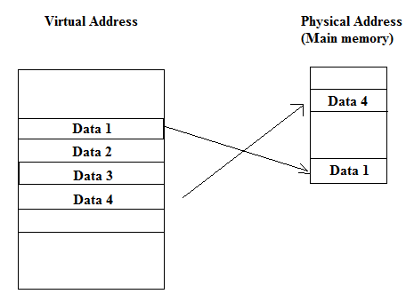
6.5 Virtual Memory
The address used by a programmer will be called a logical address
An address in main memory is called a physical address.
Programs create virtual addresses that are mapped to physical addresses by the memory manager.
Notes:
21

Slide 22
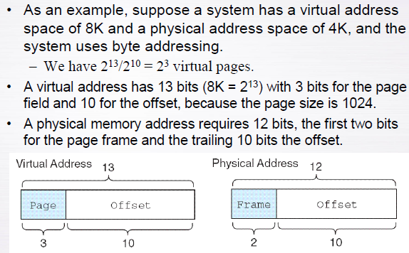
6.5 Virtual Memory
Given the size of a page = 1K
22 x 210 = 212

Slide 23
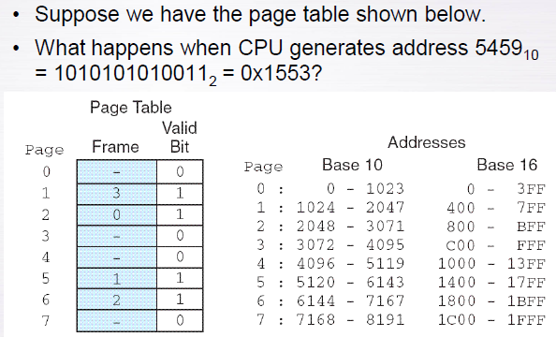
6.5 Virtual Memory
Main Memory/Physical Memory
0x denotes hexadecimal
Virtual Memory
Logical
Frame size = 1K
Page size = 1K
Note that the size of a frame is the same as the size of a page

Slide 24
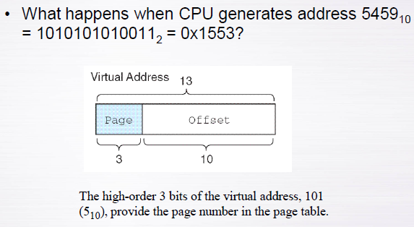
6.5 Virtual Memory

Slide 25
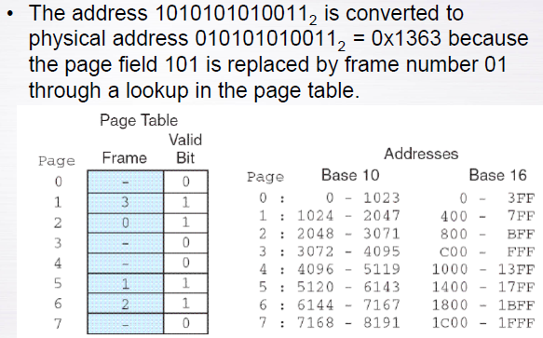
6.5 Virtual Memory

Slide 26
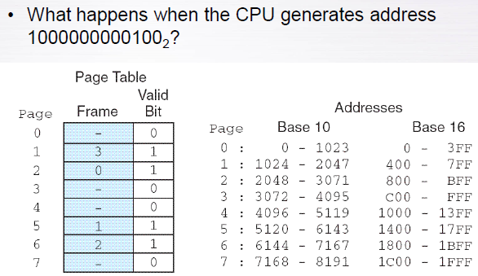
6.5 Virtual Memory

Slide 27
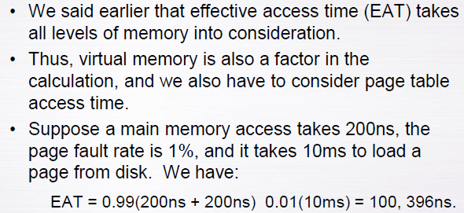
6.5 Virtual Memory
+
Even if 100% of the pages were in main memory, the effective access
time would be:
EAT = 1.00 (200ns + 200ns) = 400 ns,
which is double the access time of memory. Accessing the page table costs us an additional memory access because the page table itself is stored in main memory.
A technic called a Translation Look-aside Buffer (TLB)can be used to speed up the page table lookup by storing the most recent page lookup values in a page table cache.

Slide 28
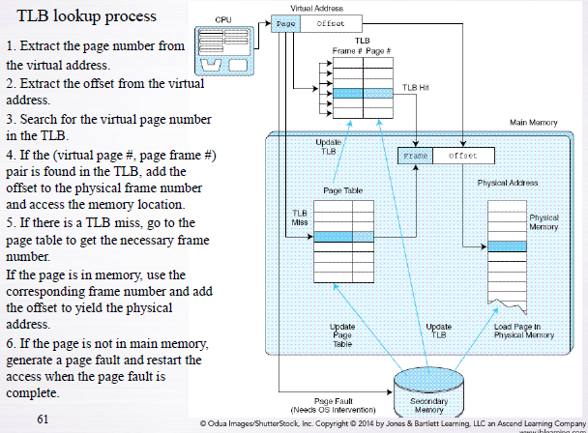
6.5 Virtual Memory

Slide 29
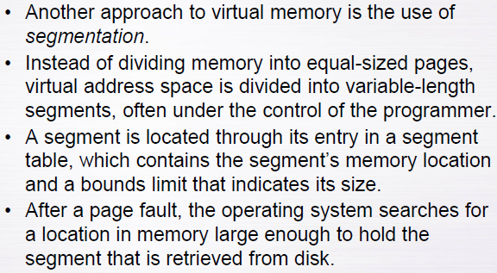
6.5 Virtual Memory

Slide 30
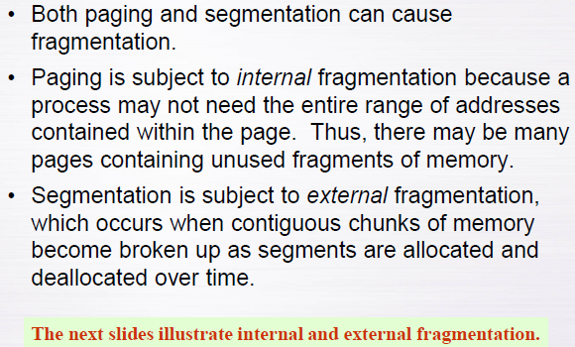
6.5 Virtual Memory

Slide 31
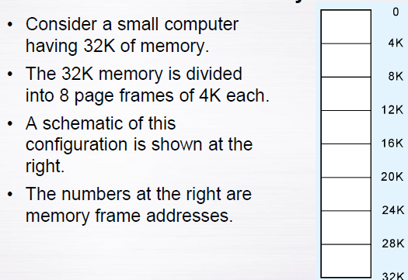
6.5 Virtual Memory

Slide 32
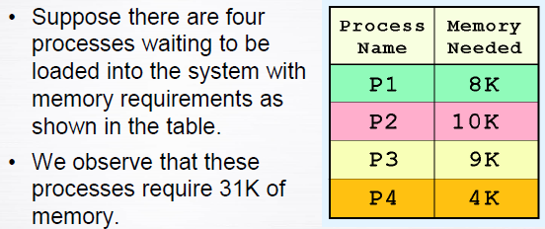
6.5 Virtual Memory

Slide 33
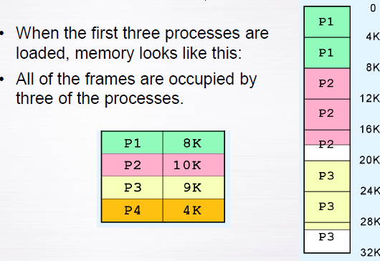
6.5 Virtual Memory

Slide 34
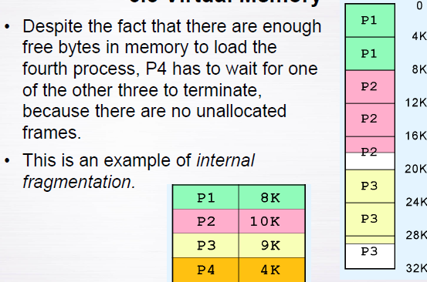
6.5 Virtual Memory

Slide 35
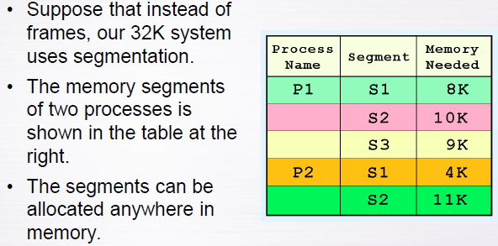
6.5 Virtual Memory

Slide 36
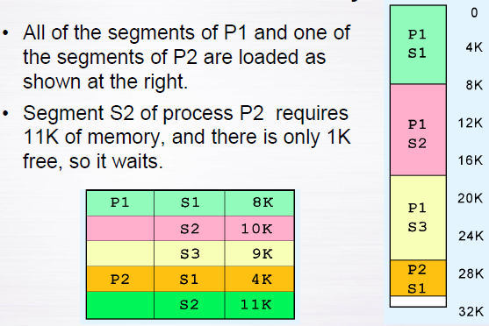
6.5 Virtual Memory

Slide 37
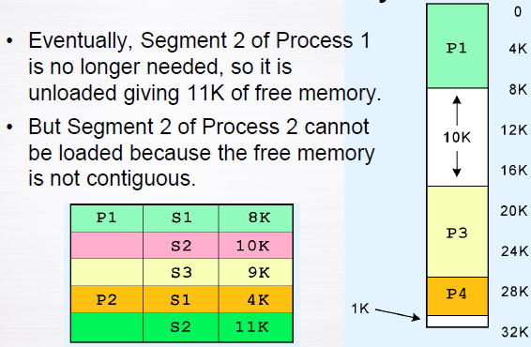
6.5 Virtual Memory

Slide 38
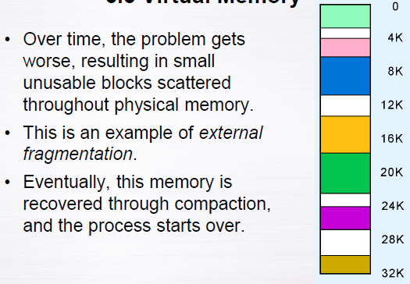
6.5 Virtual Memory

Slide 39
Chapter 6 Conclusion
With fully associative and set associative cache, as well as with virtual memory, replacement policies must be established.
Replacement policies include LRU, FIFO, or LFU. These policies must also take into account what to do with dirty blocks.
All virtual memory must deal with fragmentation, internal for paged memory, external for segmented memory.

Slide 40

kent.edu.au Kent Institute Australia Pty. Ltd. ABN 49 003 577 302 ● CRICOS Code: 00161E ● RTO Code: 90458 ● TEQSA Provider Number: PRV12051

